Slide 1

Notes:
Amigram by Douglas Hofstadter

Slide 2
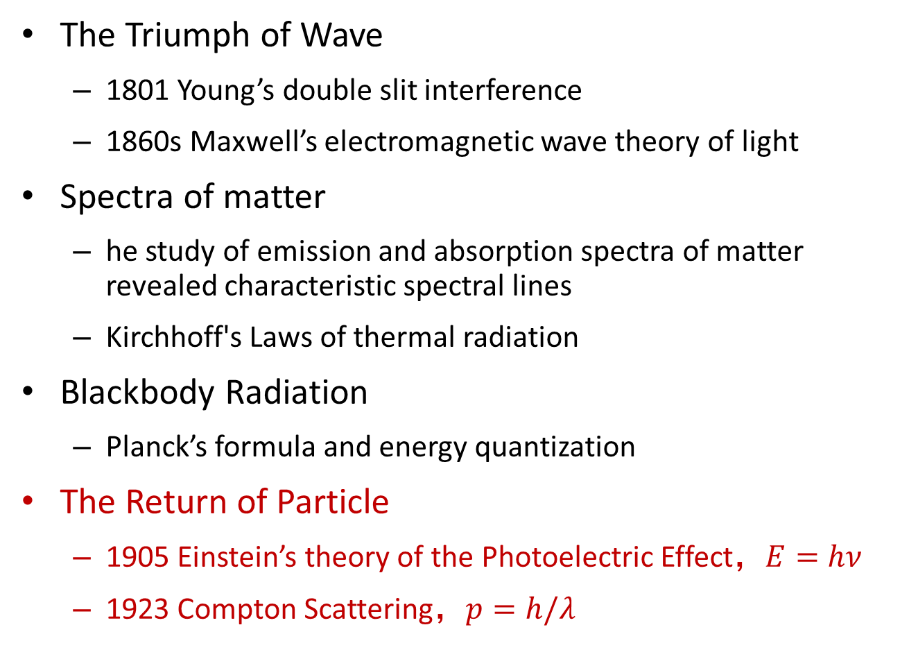
The nature of light
The Triumph of Wave
  1801 Young’s double slit interference
  1860s Maxwell’s electromagnetic wave theory of light
Spectra of matter
  he study of emission and absorption spectra of matter revealed characteristic spectral lines
  Kirchhoff's Laws of thermal radiation
Blackbody Radiation
  Planck’s formula and energy quantization
The Return of Particle
  1905 Einstein’s theory of the Photoelectric Effect，$E=hν$
  1923 Compton Scattering，$p=h/λ$

Slide 3
“I promise you four papers . . . , the first of which I could send you soon . . . The paper deals with radiation and the energetic properties of light and is very revolutionary, as you will see. . . .“
Albert Einstein 1905

Slide 4
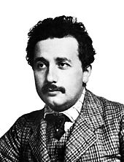
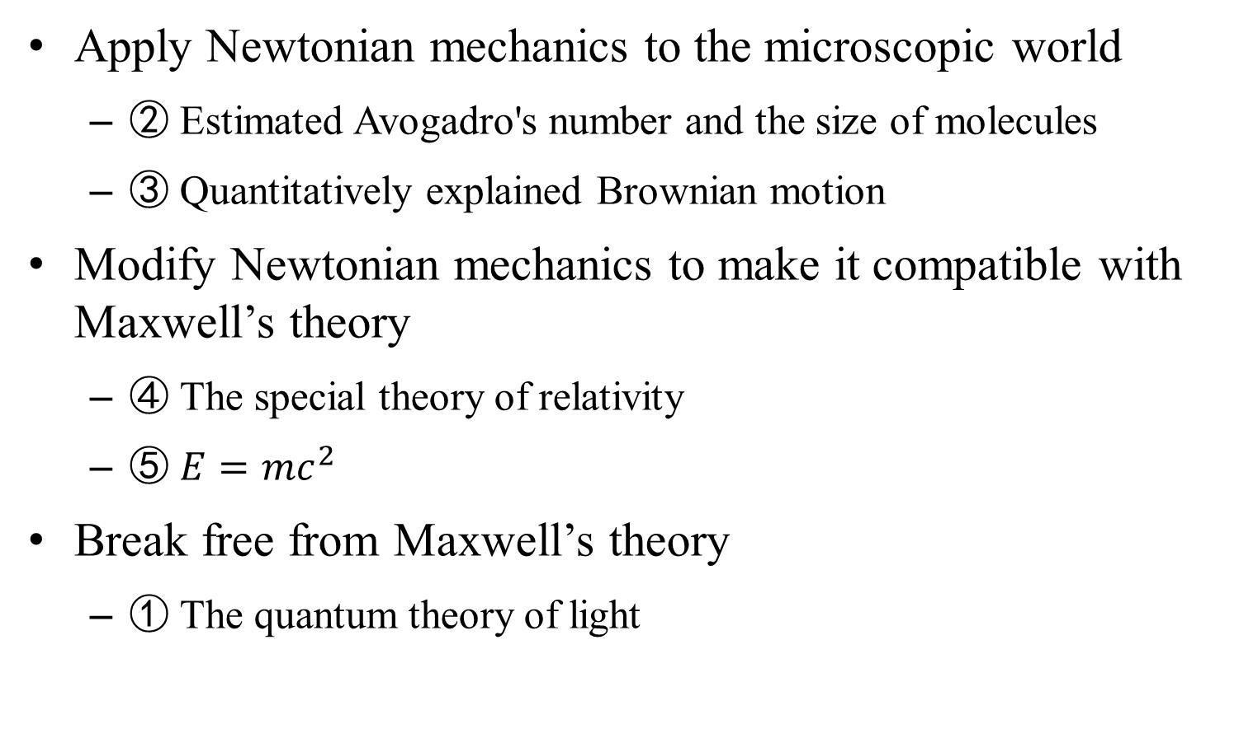
1905 Einstein’s miraculous year: five papers that change the face of physics
Apply Newtonian mechanics to the microscopic world
  ② Estimated Avogadro's number and the size of molecules
  ③ Quantitatively explained Brownian motion
Modify Newtonian mechanics to make it compatible with Maxwell’s theory
  ④ The special theory of relativity
  ⑤ $E=mc^{2}$
Break free from Maxwell’s theory
  ① The quantum theory of light
Notes:
Einstein's miraculous year: five papers that changed the face of physics

Slide 5
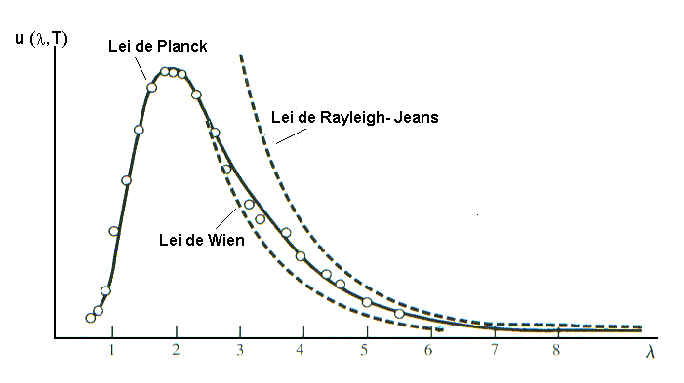

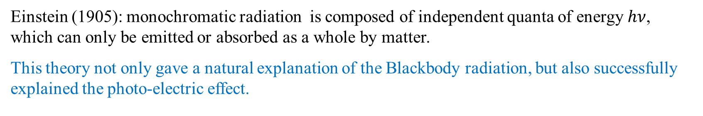
Einstein’s light quanta
Planck proposed the quantization of energy first, but he restricted his quantization to the behavior of the material oscillators and even regarded it as a mathematical trick. His quantum theory did not get much attention, and was not pursued even by himself。
Einstein (1905): monochromatic radiation is composed of independent quanta of energy $hν$, which can only be emitted or absorbed as a whole by matter.
This theory not only gave a natural explanation of the Blackbody radiation, but also successfully explained the photo-electric effect.
Blackbody
Gas molecules
B
B
$$T$$
A
A
Notes:
光量子论文实际是上这5
一个如此重大的假设如果只能用来解释一种现象是令人怀疑的。
1900从苏黎世联邦理工学院毕业后的爱因斯坦没有能够找到教职，只好在朋友父亲的帮助下在瑞士专利局找到份工作。但他并没有放弃对物理的热爱，不仅私下和好友成立了个业余组织讨论科学和哲学问题，同时自己还在苏黎世大学攻读博士。他的博士论文就是运用分子动力学解释布朗运动。
1905年博士毕业前就已近在当时顶级的德国物理学杂志发表了4,5篇论文。
他也是个热力学的专家。和普朗克不同是，他认同玻尔兹曼的分子观点，他确信热力学第二定律就是大量分子机械运动的必然结果。基于这个思想，他得出和环境处于热平衡下的系统必然会有一定得能量涨落。当能量密度特别低的时候则更明显。尽管这个结果是通过分析分子机械运动导出的，但最后的结果中只含有宏观的热力学量。因此爱因斯坦大胆把这个公式推广到另一个热平衡体系，黑体上。得出黑体辐射的能量（光强）会有涨落。这暗示，爱因斯坦很可能早已开始酝酿辐射场的量子论了。
Planck was careful not to infer anything concerning the structure of the radiation field; he restricted quantization to the behavior of the material resonators.
Einstein, in his 1905 paper, and in several subsequent papers, took up the thesis that real quanta of energy exist and that these are to be found, at least in certain experiments, in the radiation field.
Einstein's theory was developed by reasoning from fundamental assumptions with very little experimental support.
Such theories are frequently regarded with profound suspicion (or neglect) until the experimental support finally appears, and then there is likely to be enthusiastic acceptance.

Slide 6
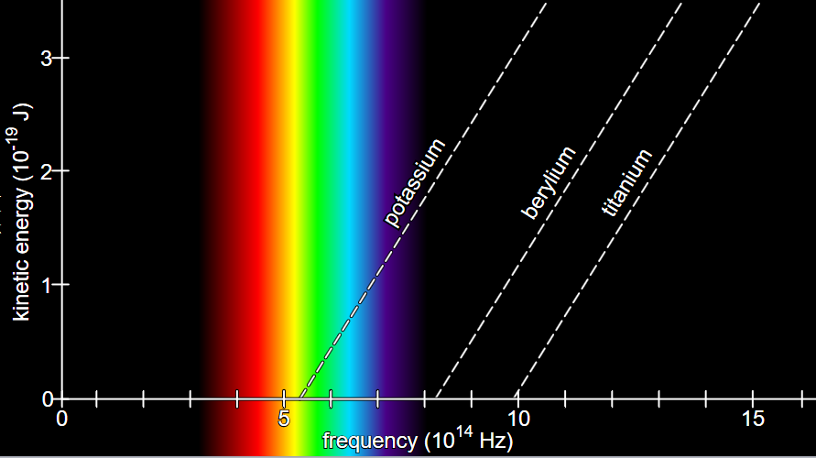
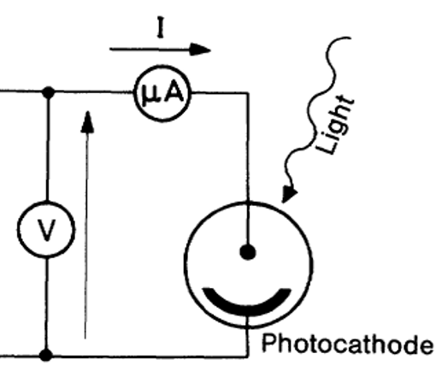
Photo electric effect
1887, Hertz, electrodes exposed to ultraviolet light were prone to discharge
1900, Lenard, Various metals emit electrons when exposed to ultraviolet light。
There is a threshold light frequency
Electron velocity is proportional to the light frequency
The current is proportional to the intensity of the light
Threshold voltage

Slide 7
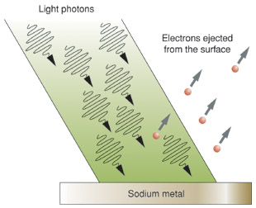
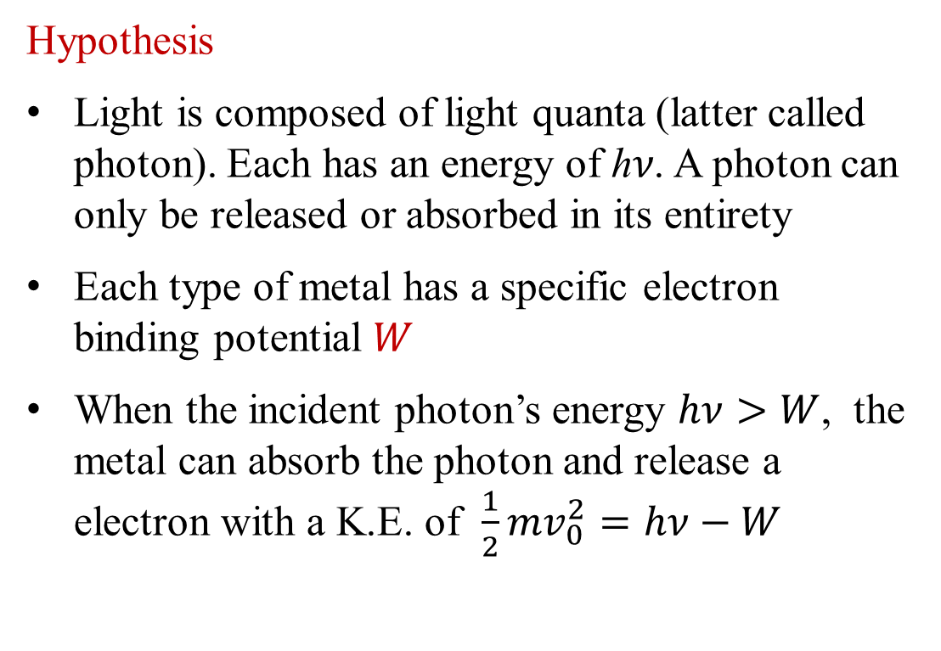
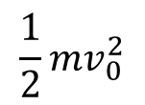

Einstein’s explanation of the photo-electric effect（1905）
Hypothesis
Light is composed of light quanta (latter called photon). Each has an energy of ℎ𝜈. A photon can only be released or absorbed in its entirety
Each type of metal has a specific electron binding potential $W$
When the incident photon’s energy $hν>W$, the metal can absorb the photon and release a electron with a K.E. of $\frac{1}{2}mv_{0}^{2}=hν−W$
$$\frac{1}{2}mv_{0}^{2}$$
$$hν$$

Slide 8
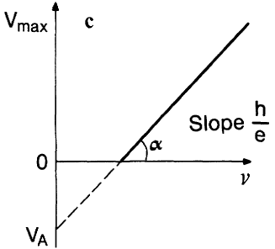
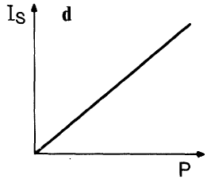
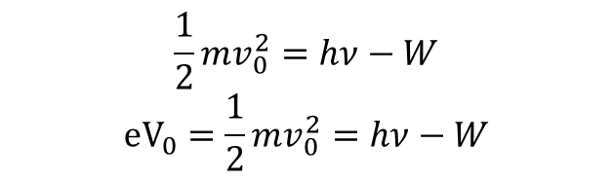
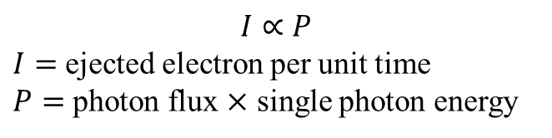

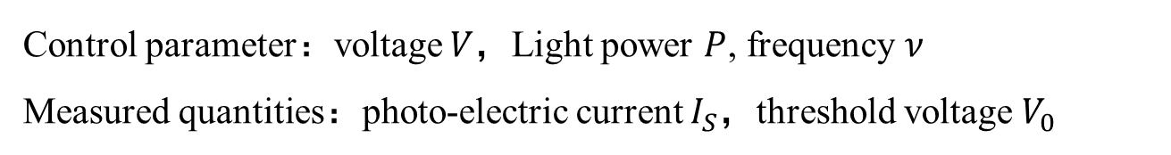



Millikan's photo electric experiment（1906-1916）
Control parameter：voltage $V$，Light power $P$, frequency $ν$
Measured quantities：photo-electric current $I_{S}$，threshold voltage $V_{0}$
$${ V}_{0}$$
$P$ fixed
$ν ,$ $V$ fixed
$$\frac{W}{e}=$$
$$\frac{1}{2}mv_{0}^{2}=hν−W$$
$${eV}_{0}=\frac{1}{2}mv_{0}^{2}=hν−W$$
$$I∝P$$
$I=$ ejected electron per unit time
$P=$ photon flux $×$ single photon energy
Notes:
密立根便是其中之一。他决定非常仔细的开展光电效应的实验，从而否定爱因斯坦的理论。

Slide 9

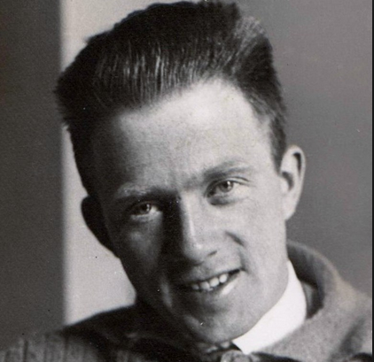
Millikan: "Although Einstein's formula is successful, its physical theory is completely wrong.”
Planck: "Einstein has made significant contributions to nearly all major fields of physics. Although he made an overreaching mistake in the theory of light quanta, such a flaw does not overshadow his overall brilliance."
Planck: “A new scientific truth does not triumph by convincing its opponents and making them see the light, but rather because its opponents eventually die, and a new generation grows up that is familiar with it.”
Notes:
“A new scientific truth does not triumph by convincing its opponents and making them see the light, but rather because its opponents eventually die, and a new generation grows up that is familiar with it.”

Slide 10
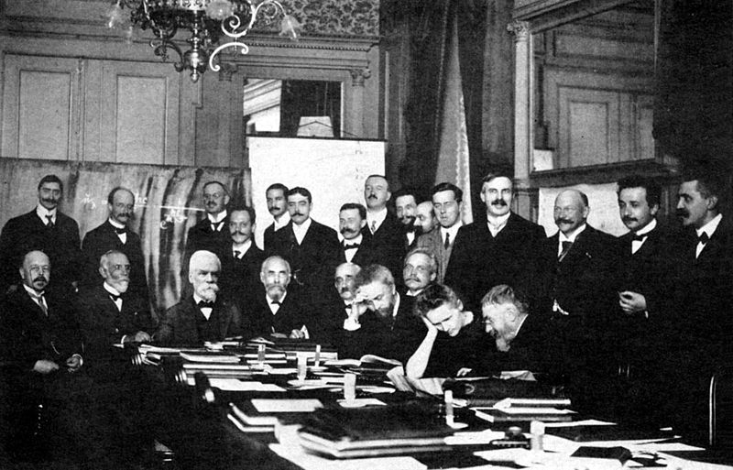
The 1st Solvay Conference 1911
The 1st Solvay conference
(Brussels)
First international physics conference
Theme topic:
Radiation and quanta
Notes:
1911年召开了第一件索尔维物理会议。资助者：Ernest Solvay（化工企业家）。这是人类历史上第一次国际物理学术会议，
主题为辐射和量子，它是量子论在物理圈的首次正式登场
Sitting(L-R):
W. Nernst, M. Brillouin, E. Solvay, H. Lorentz, E. Warburg, J. Perrin, W. Wien, M. Curie, and H. Poincaré.
Standing (L-R):
R. Goldschmidt, M. Planck, H. Rubens, A. Sommerfeld, F. Lindemann, M. de Broglie, M. Knudsen, F. Hasenöhrl, G. Hostelet, E. Herzen, J.H. Jeans, E. Rutherford, H. Kamerlingh Onnes, A. Einstein and P. Langevin.
这个会议的召开表示，量子论已被公认为物理界所面临的最重要的有待解决问题。
会议参与者都以认识到量子论的出现，物理学的发展道路将发生重大的改变。但没有人可以预测物理学会被量子论引向何方。比如，没人想到量子论和原子结构搭上什么关系，包括笑眯眯的卢瑟福。而仅仅两年之后，年轻的玻尔提出的原子的量子模型把量子论带入了新的轨道，直至量子力学和一个全新的世界观的建立。
The participants in Brussels realized that with quantum theory the course of physics was about to change. Where the development
would lead, nobody could tell. For example, it was not believed that quantum theory had anything to do with atomic structure.
Two years later, with the advent of Niels Bohr‘s atomic theory, quantum theory took a new turn that eventually would lead to quantum mechanics and a new foundation of the physicists’ world picture。

Slide 11
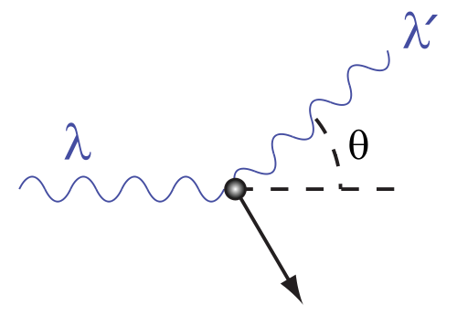
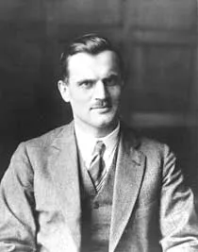
Compton scattering – photon momentum
（1923）
Notes:
这一讲，我们讨论Compton散射实验。之前我们碰到的，能够体现光的量子性的实验，它们所联系的都是光量子的能量。而这个实验则从动量的角度，进一步证实了光子的存在。

Slide 12

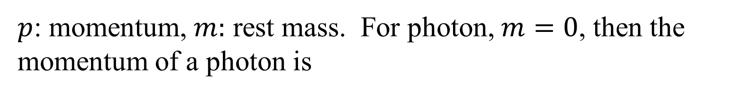
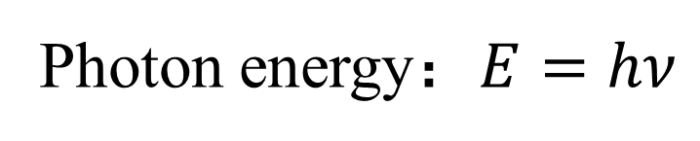
Photon energy：$E=hν$
Relativistic energy mass relation of a particle
$p$: momentum, $m:$ rest mass. For photon, $m=0$, then the momentum of a photon is
$$p=\frac{E}{c}=\frac{hν}{c}=\frac{h}{λ}$$

Slide 13
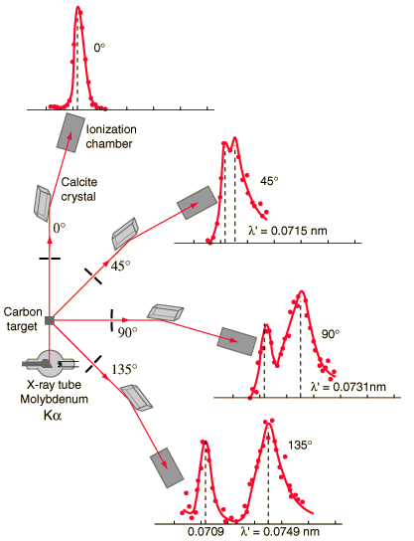
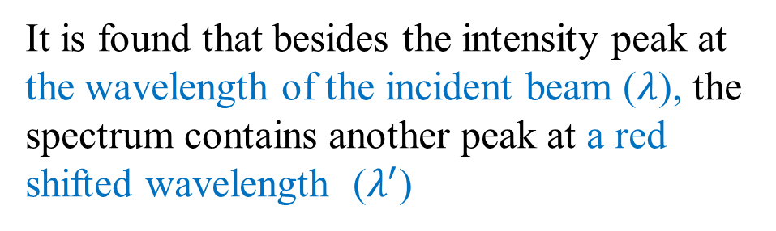


Compton’s experiment
The Calcite crystal diffracts X-rays of different wavelengths to different directions, forming a spectrum of X-rays.
It is found that besides the intensity peak at the wavelength of the incident beam ($λ$), the spectrum contains another peak at a red shifted wavelength ($λ^{′}$)
$$λ$$
$$λ^{′}−λ∝\left(1−\cos{θ}\right)$$
* If the wavelength becomes longer than the original, it is red shift. The opposite case is called blue shift.
Notes:
类似于卢瑟福散射，入射粒子为X光，靶为某种材料，比如这个图中的石墨（也就是碳）。测量的对象则是在不同方向上被散射的的x光的光谱。
实验发现，散射光谱里存在着两个主要峰，一个峰对应的波长就是原来的入射x光的波长，而另一个峰的波长则发生了红移，也就是说比原波长要长。
而两个峰的间隔则正比于1-cos（theta）

Slide 14

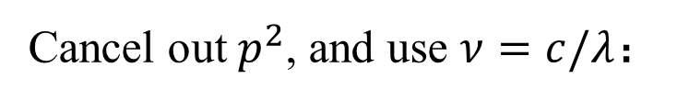


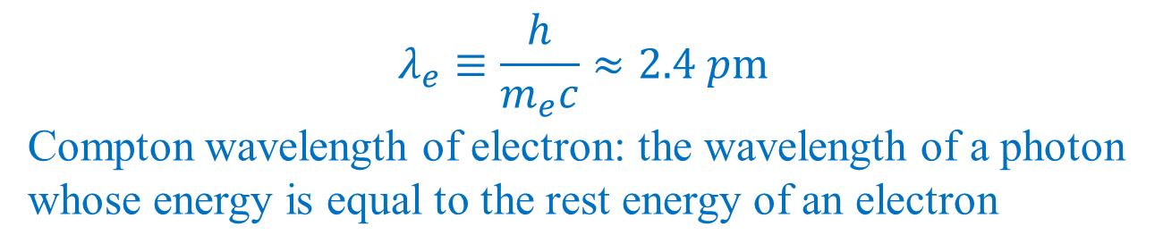
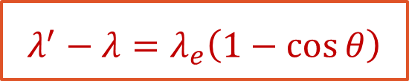



The quantum theory of Compton’s scattering
Collision between a photon and an electron. Photon momentum：$p_{λ}=\frac{h}{λ}$
Energy conservation
Momentum conservation
Cancel out $p^{2}$, and use $ν=c/λ$：
$$λ^{′}−λ=λ_{e}\left(1−\cos{θ}\right)$$
$$φ$$
$$p_{λ^{′}}$$
$$λ_{e}≡\frac{h}{m_{e}c}≈2.4 pm$$
Compton wavelength of electron: the wavelength of a photon whose energy is equal to the rest energy of an electron
$$p$$
$$p$$
$$θ$$
$$p_{λ}$$
By fitting the $cosθ$ dependence of $λ^{′}$, we have another method of measuring $h$
Notes:
这样一个现象可以用光子和电子碰撞的模型来很好的解释。
首先经典电动力学也认为电磁波具有动量，其动量值为E/c. 。。。。。，因此光子的动量也和频率成正比，或者和它的波长成反比。
一开始，假设电子是静止的，而入射光的波长为lambda，动量为。。，碰撞后双方的动量都发生了改变，对于光子来说，它的波长也就发生了改变。
第二个方程，是动量守恒，这些动量的大小满足余弦定理。而第一个等式代表能量守恒。这是一个满足相对论的能量公式。
因此康普顿散射的发现是光量子论的决定性胜利，自此之后没有人再怀疑光子的存在了。

Slide 15
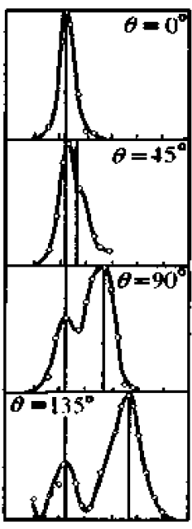
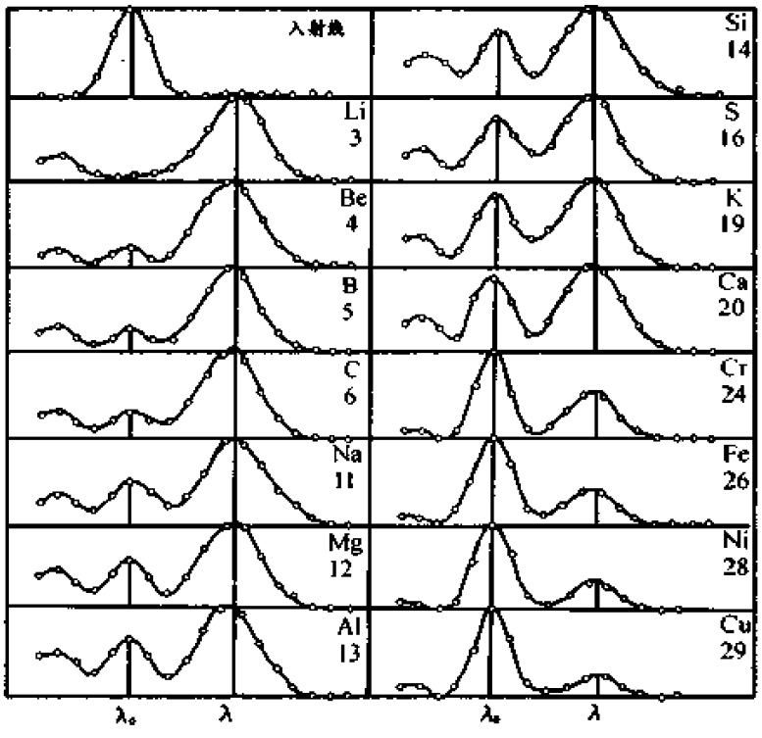


$$θ={145}^{°}$$
散射光强度
散射光波长
$$λ$$
$$λ′$$
$$λ$$
$$λ′$$
Graphite X-ray spectra taken
at different scattering angles
  The spectral component of the original wavelength increases with increasing atomic number

Slide 16
The nature of light
Particle or Wave?
There are ... now two theories of light,
both indispensable ...
with no logical connection.
— Einstein, 1924
Notes:
Although the photoelectric effect and the Compton effect were historically regarded as direct evidence of the quantum nature of light, strictly speaking, these phenomena could still be explained by quantizing the matter that interacts with the light, while treating the light as a classical wave.
From a modern perspective, the complete confirmation of the quantum nature of light had to wait until the discovery of the non-classical light antibunching effect after 1960.

